Slide 1
Project Roadmap: Human Activity Recognition
Name | Enrollment Number | Email ID | Section | Phone Number
Ajinkya Bedekar | U101116FCS183 | Ajinkya.Bedekar@st.niituniversity.in | C5 | 7389664860
Ankit Gupta | U101116FCS267 | Ankit.Gupta@st.niituniversity.in | C5 | 9660765363
Deeptonabho Dutta | U101116FCS030 | Deeptonabho.Dutta@st.niituniversity.in | C5 | 9674525644
Dhruva Agarwal | U101116FCS177 | Dhruva.Agarwal@st.niituniversity.in | C5 | 7339764074

Slide 2
Overview
Expected delivery
April 30, 2019
Recent progress
Studying basics of Machine Learning, Deep Learning, Computer Vision, Artificial Intelligence
Studying basics of OpenCV, Neural Networks
Biggest risk
To avoid ambiguity about whether the activity performed by human at railway station is really suspicious or not

Slide 3
Technologies To Be Used
THOSE TAUGHT IN CLASS
OpenCV
THOSE WHICH ARE SELF-TAUGHT BY US
Neural network
Convolutional Neural Network
Keras
TensorFlow

Slide 4
Schedule

Slide 5
Object Detection: Learning + Implementation
Human Activity Recognition: Learning + Implementation
Final Implementation
1 February 2019
20 February 2019
10 March 2019
1 April 2019
20 April 2019
Object Tracking: Learning + Implementation
Train Software on Suspicious Activities Dataset

Slide 6
Scope
Step 1: Human body recognition
Step 2: Basic human activity tracking like sitting, standing.
Step 3: Defining unambiguous suspicious activities in a railway station
Step 4: Train model to track the defined suspicious activities with maximum probability.

Slide 7
Unambiguous
(Suspicious) Activities
Evasive answers to security questions
Placing a package in a different compartment
Tampering with security equipment
Documenting transit equipment, facilities or security equipment
Abandoning a vehicle

Slide 8
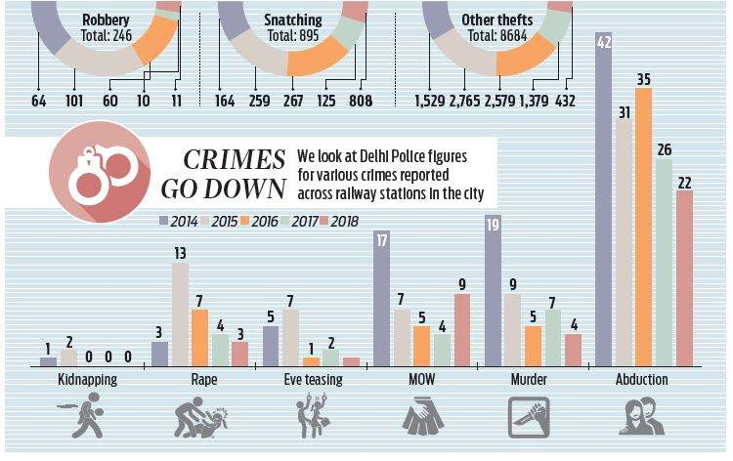
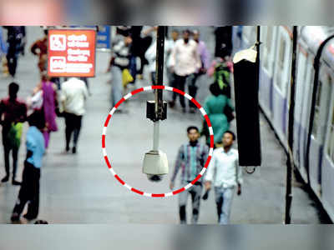

Slide 9
Roles and Responsibilities
Name | Module
Ajinkya Bedekar | Object Detection
Ankit Gupta | Object Tracking
Deeptonabho Dutta | Human Activity Recognition (Suspicious)
Dhruva Agarwal | Train Software and Final Implementation

Slide 10
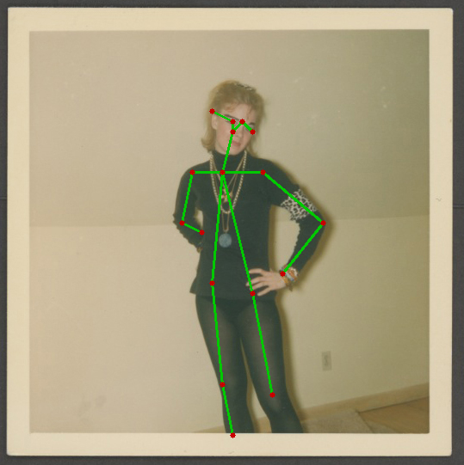
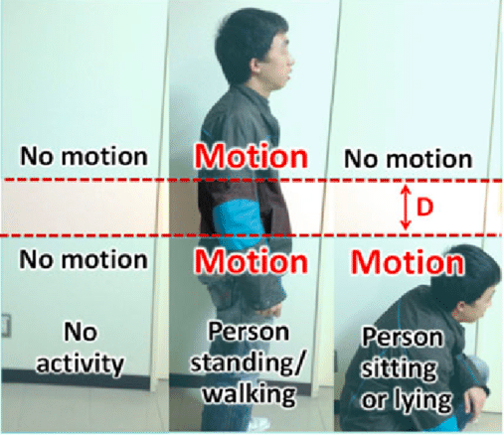
Step1: Human body recognition Step 2: Basic human activity tracking

Slide 11
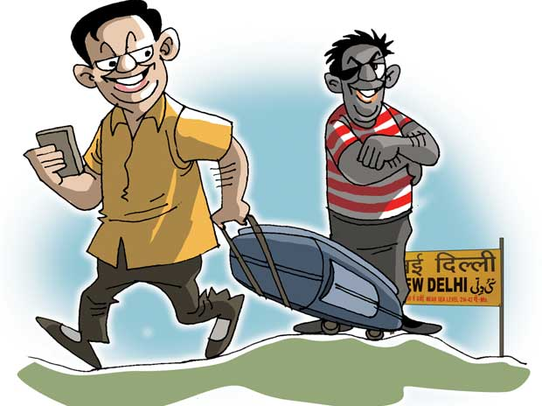
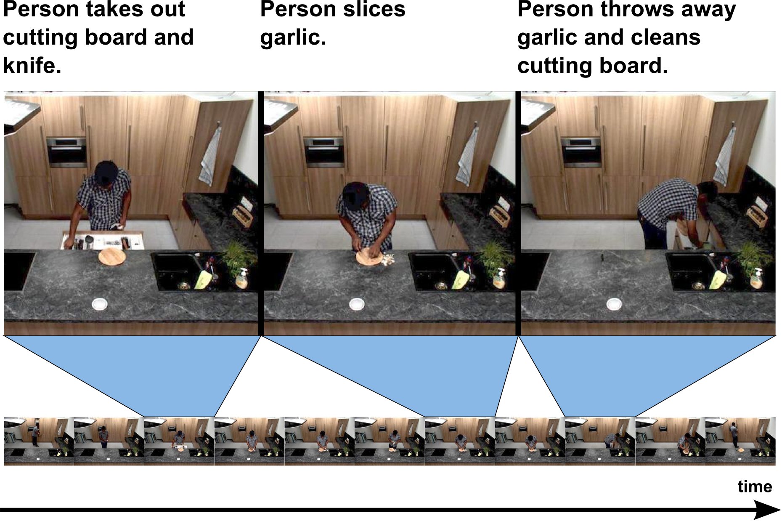
Step3: Defining unambiguous suspicious Step 4 : Training the model
activities in a railway station

Slide 12
Workflow
Extract frame from video
Image Preprocessing
Detect Activity
Use trained model to detect suspiciousness
Yes
No
Send alert to admin
Proceed to next frame

Slide 13
Next Deliverable
Research on Object Detection
Start developing the algorithm for detecting objects real-time through camera
Work done so far

